Slide 1
Battle of the Blockbusters: Comparing Genre Ratings in
Hollywood vs. Bollywood Films
Team 2A
Lalitha Priya Bhupalam
Ruicheng Li
Hilary Nguyen
Abhinav Samavedula
Chun-Hui Tsai

Slide 2
Hollywood ?
Bollywood ?
Hollywood is the American film industry.
It's known for producing big-budget blockbuster films, often featuring high-profile stars.
Hollywood focuses on its cinematic filmmaking techniques.
Bollywood is the Indian film industry.
It's famous for its musical numbers,
emotional plots, and star-driven films.
These films explore family-oriented relationships.

Slide 3
Kaggle
2012 - 2022
Two sample t-test
α=0.05
Avg. rating from IMDB
Genre
Where do our data come from
Years of our data
What analyzing method do we use
What is our comparing metric
How do we categorize

Slide 4
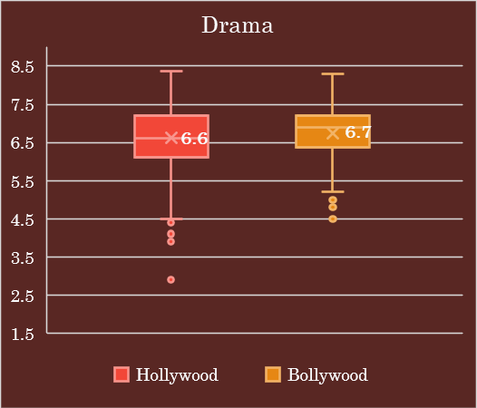
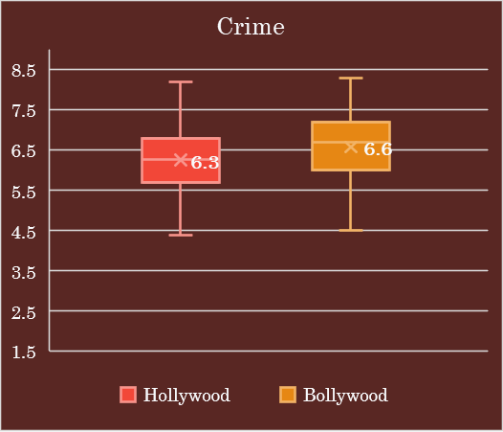
The average rating for Bollywood in Drama and Crime is significantly higher.

Slide 5
Conclusion
According to the data…
Objective | Hollywood | Bollywood
Drama
Romance
Comedy
Action
Crime
Producer Perspective
Hollywood should focus on creating more films in the Comedy and Action genres.
Bollywood should prioritize the production of Drama and Crime movies.

Slide 6
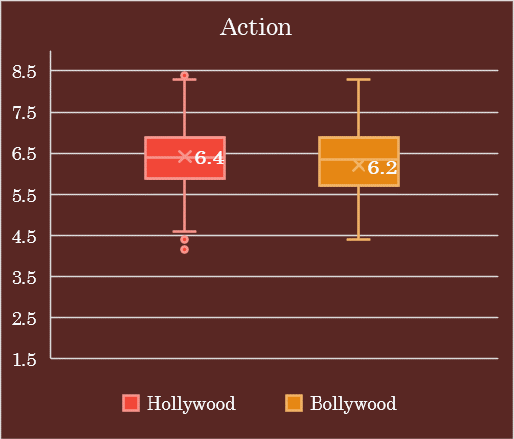
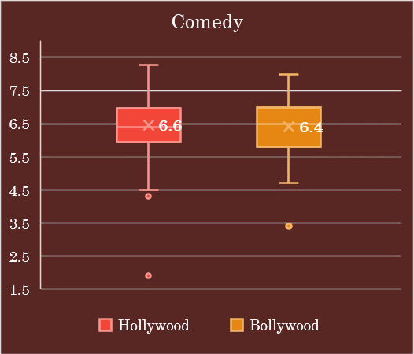
The average rating for Hollywood in Action and Comedy is significantly higher.

Slide 7
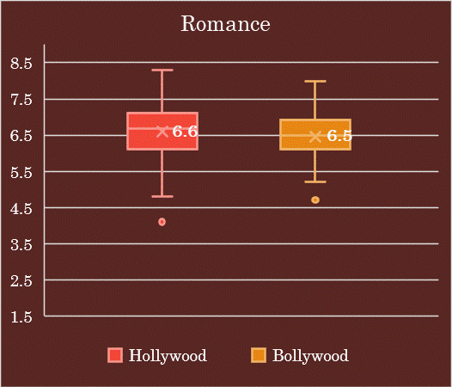
The average ratings for Hollywood and Bollywood in Romance has no significant difference

Slide 8


# 1 BOLLYWOOD MOVIES
#1 Bollywood Crime & Drama
#1 Bollywood Romance

Slide 9



#1 HOLLYWOOD MOVIES
#1 Hollywood Romance
#1 Hollywood Action
#1 Hollywood Comedy

Slide 10


